Slide 1
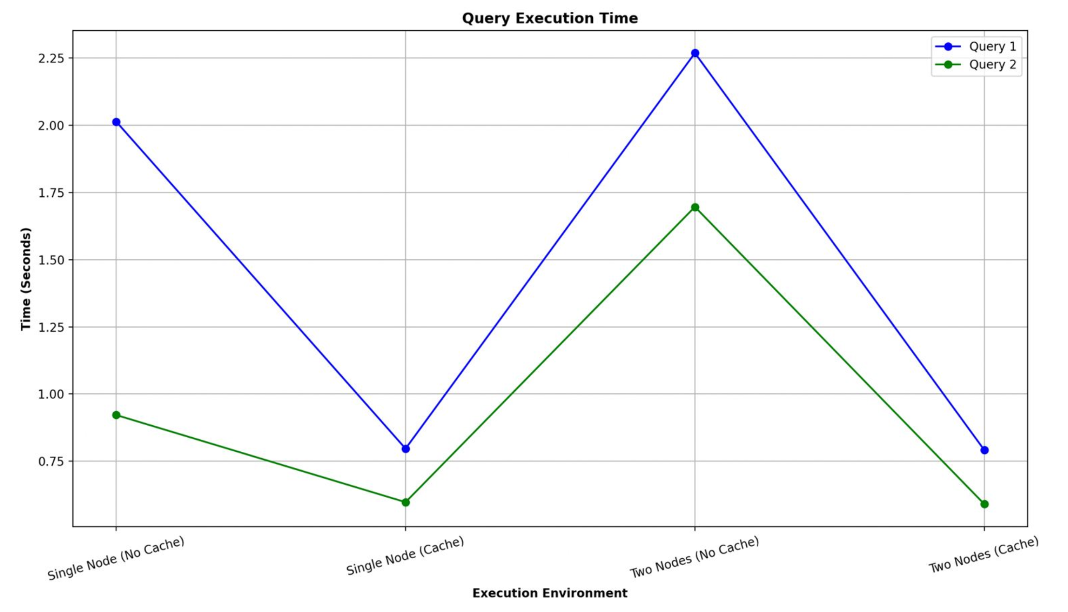

MINI 2: TEAM NEXABYTES
C
A
B
E
Built a 5-process system (A-E) using gRPC across 2 machines.
A handles client queries; B-E hold split data chunks.
Used overlay shown: A-B, B-C, B-D,C-E D-E.
A checks cache before forwarding queries.
D
Client

